Slide 1



KG Information Systems Private Limited
ASPIRING MINDS
AJAY KUMAR R

Slide 2

QUESTION 1 - [RESPECTABLE]
Proof of Concept to demonstrate an application designed using Dependency Injection design pattern. Expected the architecture and an implementation approach with a sample project

Slide 3



Q1 : Dependency Injection Implementation
Source Code GIT Repository:
Web Browser Link:
https://github.com/Ajay-Kumar-Aspiring-Minds-Round-2/DependencyInjectionApp
GIT Clone Link:
https://github.com/Ajay-Kumar-Aspiring-Minds-Round-2/DependencyInjectionApp.git
Technology Stack :
What is Dependency Injection?
Dependency Injection is the ability of an object to supply dependencies of another object.
DI pattern separates the responsibility of creating an object of the service class out of the client class.

Slide 4
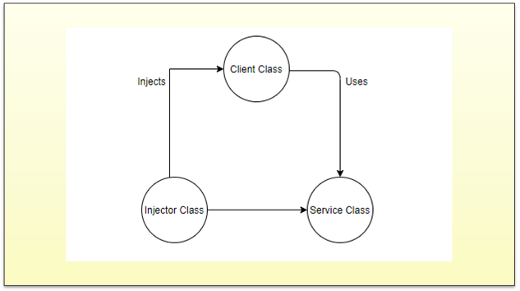
Q1 : Relationship between the classes (DI Components)

Slide 5
Q1 : DI Components & Types of Dependency Injection
DI Components
Client Class: This is the dependent class and is dependent on the Service class.
Service Class: This class provides a service to the client class.
Injector Class: This class is responsible for injecting the service class object into the client class
Types of Dependency Injection
Constructor Injection: In this type of injection, the injector supplies dependency through the client class constructor.
Setter Injection / Property Injection: In this type of injection, the injector method injects the dependency to the setter method exposed by the client.
Interface Injection: In this type of injection, the client class implements an interface which declares the methods to supply the dependency and the injector uses this interface to supply the dependency to the client class.

Slide 6
Q1 : Benefits of using Dependency Injection
Benefits of using Dependency Injection
Helps in Unit testing.
Boiler plate code is reduced, as initializing of dependencies is done by the injector component.
Extending the application becomes easier.
Helps to enable loose coupling, which is important in application programming.

Slide 7
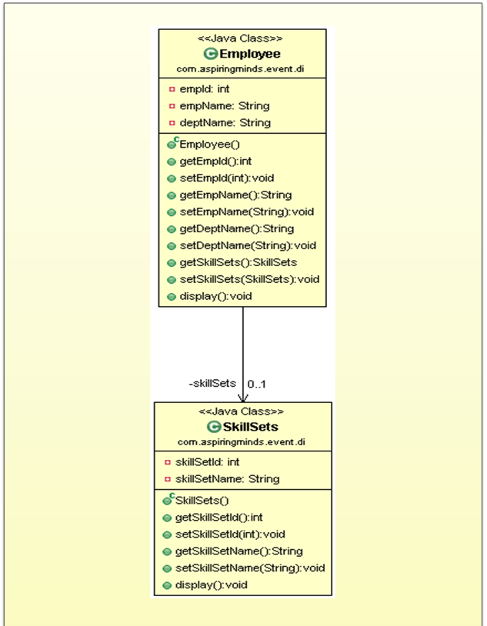
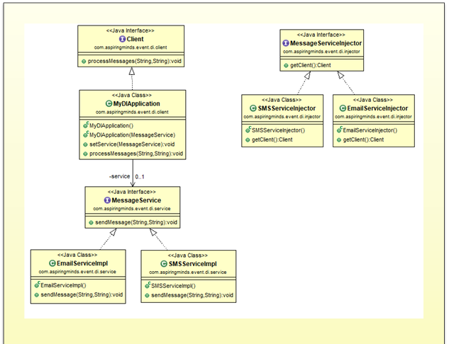
Q1 : Class Diagram

Slide 8
Q1 : Detailed documents with Code Snippet Explanation & Screenshots.
Note: Detailed documents attached here for further reference

Slide 9
QUESTION 2 - [AMBITIOUS]
Create a Progressive Web App that allows readers to keep up with all topics, news, and events they care about, from one single place. The platform should bring news and stories from around the world together in a magazine format.

Slide 10




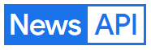
Q2 : Progressive Web App – News App
Source Code GIT Repository:
Web Browser Link:
https://github.com/Ajay-Kumar-Aspiring-Minds-Round-2/newsapp
GIT Clone Link:
https://github.com/Ajay-Kumar-Aspiring-Minds-Round-2/newsapp.git
Technology Stack :
Key Features of News App – News can be viewed of nearly 54 Countries.
1
2
3
4
5
Business News
Technology News
General News
Health News
Science News
6
7
8
9
Entertainment News
Sports News
Search News
App Settings

Slide 11
Q2 : News API (Open Source API) - Used for fetching live latest news, events and stories.
News API has 2 main endpoints:
Top headlines - /v2/top-headlines
Returns breaking news headlines for a country and category, or currently running on a single or multiple sources. This is perfect for use with news tickers or anywhere you want to display live up-to-date news headlines and images.
This endpoint provides live top and breaking headlines for a country, specific category in a country, single source, or multiple sources. You can also search with keywords. Articles are sorted by the earliest date published first.
2. Everything - /v2/everything
We index every recent news and blog article published by over 50,000 different sources large and small, and you can search through them with this endpoint. This endpoint is better suited for news analysis and article discovery, but can be used to retrieve articles for display too.
Search through millions of articles from over 50,000 large and small news sources and blogs. This includes breaking news as well as lesser articles.
This endpoint suits article discovery and analysis, but can be used to retrieve articles for display, too.
We also have a minor endpoint that can be used to retrieve a small subset of the publishers we index from:
3. Sources - /v2/sources
Returns information (including name, description, and category) about the most notable sources we index. This list could be piped directly through to your users when showing them some of the options available.
This endpoint returns the subset of news publishers that top headlines (/v2/top-headlines) are available from. It's mainly a convenience endpoint that you can use to keep track of the publishers available on the API, and you can pipe it straight through to your users.

Slide 12
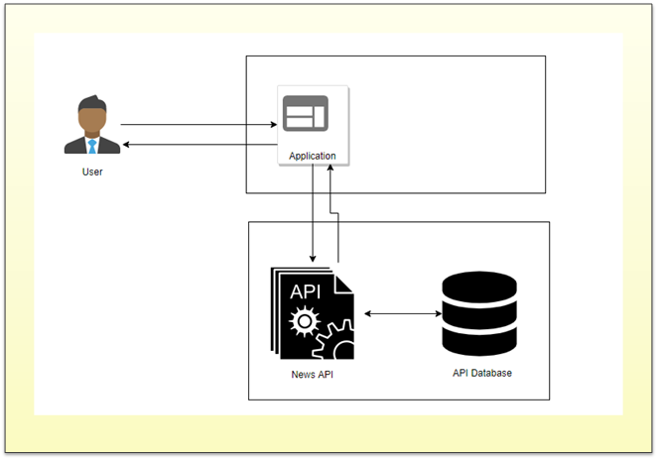
Q2 : Application Architecture Diagram

Slide 13
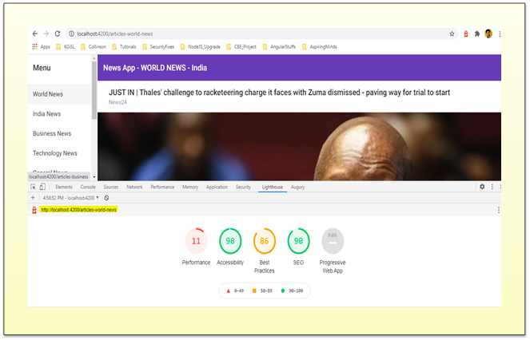
Q2 : PWA Audit Report with Lighthouse (Open-Source Tool from Google)

Slide 14
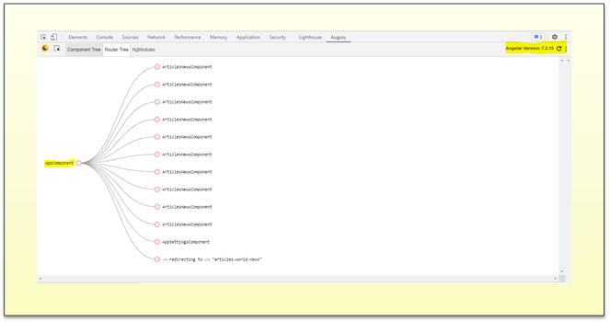
Q2 : Router Tree Structure of Components

Slide 15
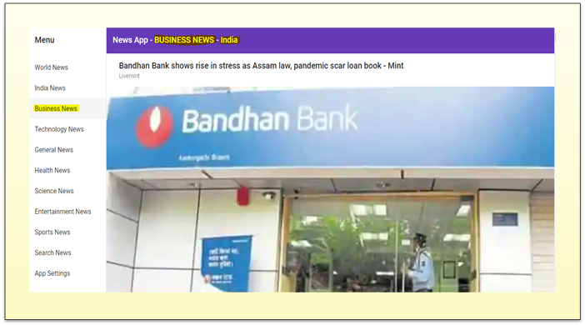
Q2 : Business News for the selected country - India

Slide 16
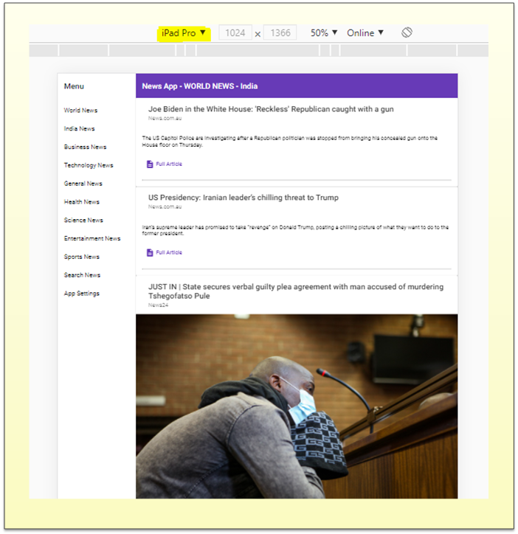
Q2 : Mobile Browser View of News App

Slide 17
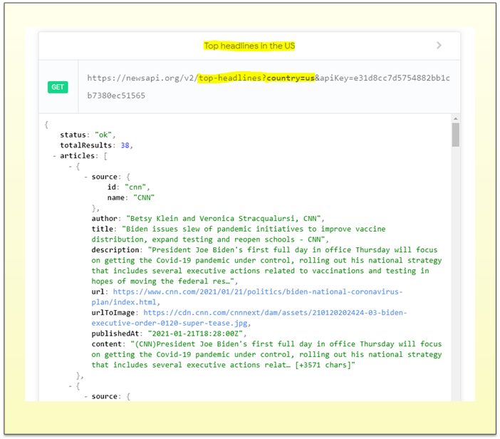
Q2 : Sample News API Request & Response for Top headlines in the US

Slide 18
Q2 : Detailed documents & Screenshots.
Note: Detailed documents attached here for further reference

Slide 19
QUESTION 3 - [AMBITIOUS]
Design an Architecture and a proof of concept development which can be used for searching the resume bank (repository can be file system, database etc.) where based on the keywords given resumes can be picked with top to bottom relevancy or occurrence. Solution can also include any open source algorithm or framework. When there is a Job Description comes and a set of keyword entered the system shall go and check the prediction on how many resume matches we have in the resume bank.

Slide 20


Q3 : Resume Ranker App
Source Code GIT Repository:
Web Browser Link:
https://github.com/Ajay-Kumar-Aspiring-Minds-Round-2/ResumeRanker
GIT Clone Link:
https://github.com/Ajay-Kumar-Aspiring-Minds-Round-2/ResumeRanker.git
Java API/Libraries:
Key Features of Resume Ranker
1
2
3
Convert Doc to Text
Resume Indexer
Resume Searcher

Slide 21
Q3 : Resume Ranker App
Resume Ranker application creates an index over all available resumes under the inputFiles folder. It then performs query search, once a particular keyword is given. Finally, it outputs top resumes matching a given keyword.
Resume Ranker application uses Lucene which is a full-text search library completely written in Java. It adds the content to full-text index and then allows you to perform queries on this index, returning results ranked by either the relevance to the query or sorted by an arbitrary field such as a document’s last modified date.
Lucene Core is a Java library providing powerful indexing and search features.

Slide 22
Q3 : TF-IDF Algorithm
TF-IDF algorithm: is used to derive a score or rank for the document based on the search term.
TF-IDF stands for Term frequency-inverse document frequency.
The tf-idf weight is a weight often used in information retrieval and text mining. Variations of the tf-idf weighting scheme are often used by search engines in scoring and ranking a document’s relevance given a query.
This weight is a statistical measure used to evaluate how important a word is to a document in a collection or corpus. The importance increases proportionally to the number of times a word appears in the document but is offset by the frequency of the word in the corpus (data-set).
How to Compute:
TF-IDF is a weighting scheme that assigns each term in a document a weight based on its term frequency (tf) and inverse document frequency (idf). The terms with higher weight scores are considered to be more important.

Slide 23
Q3 : Resume Ranker App
Typically, the tf-idf weight is composed by two terms:
1. Normalized Term Frequency (tf)
Frequency indicates the number of occurrences of a particular term t in document d.
(Term frequency is the occurrence count of a term in one particular document only)
tf(t, d) = N(t, d) / ||D|| wherein,
tf(t, d) = term frequency for a term t in document d.
N(t, d) = number of times a term t occurs in document d.
||D|| = Total number of term in the document.
2. Inverse Document Frequency (idf)
It typically measures how important a term is. The main purpose of doing a search is to find out relevant documents matching the query. Document frequency is the number of different documents the term appears in.
idf(t) = log(Total Number Of Documents / Number Of Documents with term t in it)
TF-IDF Scoring:
As we have defined both tf and idf and now we can combine these to produce the ultimate score of a term t in document d. Therefore,
tf-idf(t, d) = tf(t, d) * idf(t, d)

Slide 24
Q3 : Detailed documents with Code Explanation & Screenshots.
Note: Detailed documents attached here for further reference

Slide 25
QUESTION 5 - [AMBITIOUS]
Multi-tenant architecture with single instance of application layer which will have separate database for each client. Expected the architecture and approach document as output.

Slide 26

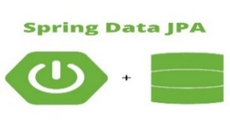



Q5 : Multi-Tenant App
Source Code GIT Repository:
Web Browser Link:
https://github.com/Ajay-Kumar-Aspiring-Minds-Round-2/MultiTenantApp
GIT Clone Link:
https://github.com/Ajay-Kumar-Aspiring-Minds-Round-2/MultiTenantApp.git
Technology Stack:
Database per Tenant approach is followed to implement the sample Multi-tenant App.

Slide 27
Q5 : Multi-Tenant App
What is Multi-tenancy?
Multi-tenancy is an architecture in which a single instance of a software application serves multiple customers. Each customer is called a tenant.
We can implement multi-tenancy using any of the following approaches:
Database per Tenant: Each Tenant has its own database and is isolated from other tenants.
Shared Database, Shared Schema: All Tenants share a database and tables. Every table has a Column with the Tenant Identifier that shows the owner of the row.
Shared Database, Separate Schema: All Tenants share a database, but have their own database schemas and tables.
Tenant ID found from URL and operations are performed based on current tenant id.
(Ex: http://app.com/api/tenant_id/, http://localhost:8080/tenant_id)

Slide 28
Q5 : Multi-Tenant App - MVC Framework
Application is built using the MVC web application framework.
The Model-View-Controller (MVC) is an architectural pattern that separates an application into three main logical components: the model, the view, and the controller.
The Model is responsible for managing the data of the application. It responds to the request from the view and it also responds to instructions from the controller to update itself.
The View is responsible for rendering the model data and in general it generates HTML output that the client's browser can interpret.
The Controller is responsible for processing user requests and building an appropriate model and passes it to the view for rendering.
Employee is our Domain/POJO class.
Creating a Repository for our Employee class is pretty simple using Spring. For our basic CRUD operations we only need to create an interface that extends Spring's own CrudRepository. Again nothing specific needs to be done here to support multi-tenancy.
JPA with spring data repository model.

Slide 29
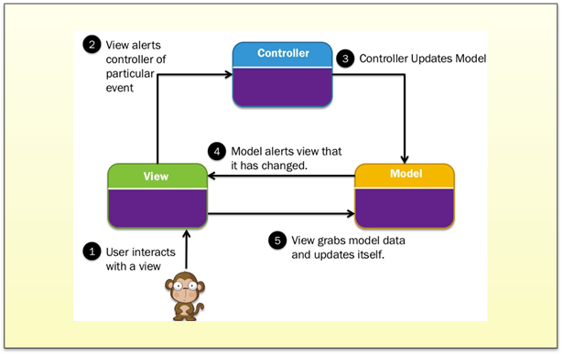
Q5 : Multi-Tenant App - MVC Architecture Diagram

Slide 30
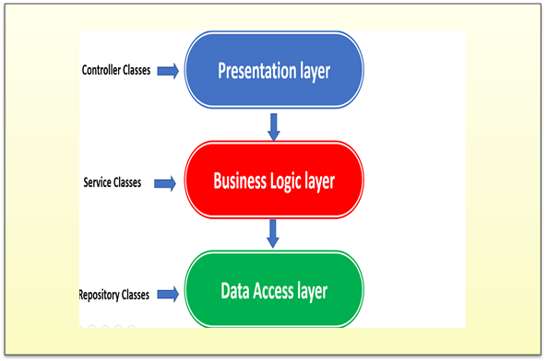
Q5 : Multi-Tenant App - Application Architecture Diagram

Slide 31
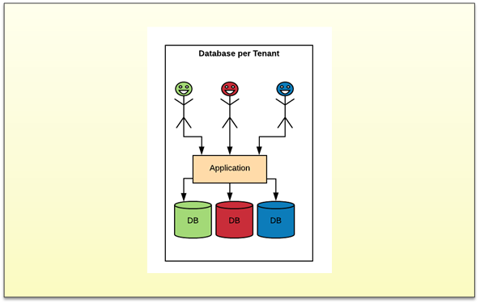
Q5 : Multi-Tenant App - Database per Tenant Architecture View

Slide 32
Q5 : Detailed documents with Code Explanation & Screenshots.
Note: Detailed documents attached here for further reference

Slide 33
QUESTION 7 - [RESPECTABLE]
Proof of Concept to demonstrate sharing session between different applications. Expectation is to have scalable session management where there is addition of new applications.

Slide 34

Q7 : Sharing Session across different applications
Source Code GIT Repository:
Web Browser Link:
https://github.com/Ajay-Kumar-Aspiring-Minds-Round-2/SharingSession
GIT Clone Link:
https://github.com/Ajay-Kumar-Aspiring-Minds-Round-2/SharingSession.git
Technology Stack:

Slide 35
Q7 : Sharing Session across different applications
Key Points & Configurations:
Spring Session provides an API and implementations for managing a user’s session information.
Spring Session’s below modules are used in the sample Sharing Session App.
Spring Session Core - provides core Spring Session functionalities and APIs
Spring Session Data Redis - provides SessionRepository and ReactiveSessionRepository implementation backed by Redis and configuration support.
Spring Session uses Redis to back a web application’s HttpSession when using Spring Boot.
The user’s information is stored in Redis rather than Tomcat’s HttpSession implementation.

Slide 36
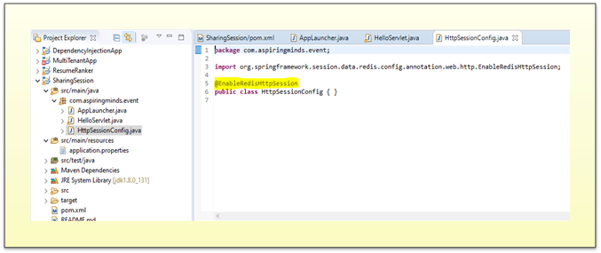
Q7 : Sharing Session across different applications
Spring Configuration
We can create a Spring configuration which is responsible for creating a Servlet Filter that replaces the HttpSession implementation with an implementation backed by Spring Session.
Add the below Spring Configuration which is shown in the screenshot:

Slide 37
Q7 : Sharing Session across different applications
The @EnableRedisHttpSession annotation creates a Spring Bean with the name of springSessionRepositoryFilter that implements Filter. The filter is what is in charge of replacing the HttpSession implementation to be backed by Spring Session. In this instance Spring Session is backed by Redis.

Slide 38
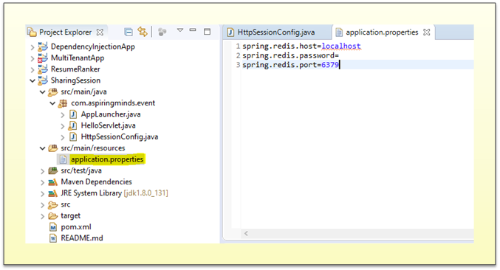
Q7 : Sharing Session across different applications
Configuring the Redis Connection
Spring Boot automatically creates a RedisConnectionFactory that connects Spring Session to a Redis Server on localhost on port 6379 (default port).
We can add the below code snippet under application.properties file.

Slide 39
Q7 : Sharing Session across different applications
Spring Session uses Redis to back a web application’s HttpSession when using Spring Boot.
The user’s information is stored in Redis rather than Tomcat’s HttpSession implementation.
Instead of using Tomcat’s HttpSession, we are actually persisting the values in Redis. Spring Session replaces the HttpSession with an implementation that is backed by Redis.
When a new HttpSession is created, Spring Session creates a cookie named SESSION in your browser that contains the id of your session.
App consists of an Embedded Tomcat that has a single HelloServlet servlet. When issuing a GET request, the servlet will respond with either the default Hello World! or if the name session attribute has been set with Hello [name]. The name session attribute can be changed by issuing a POST request with a name parameter.

Slide 40
Q7 : Detailed documents with Code Explanation & Screenshots.
Note: Detailed documents attached here for further reference

Slide 41
QUESTION 8 - [PAINLESS]
Proof of concept to demonstrate screen level field validations using regular expression. Expectation is to demonstrate, number, text, PAN, Passport currency, age, restricting special characters, restricting character range, restricting number range, restricting date range etc. solution shall be not limiting the mentioned sample validations.

Slide 42


Q8 : User App Field Validations using Regular Expression
Source Code GIT Repository:
Web Browser Link:
https://github.com/Ajay-Kumar-Aspiring-Minds-Round-2/userapp
GIT Clone Link:
https://github.com/Ajay-Kumar-Aspiring-Minds-Round-2/userapp.git
Technology Stack:

Slide 43
Q8 : User App Field Validations using Regular Expression
Key Features:
Angular UI for entering user details.
Angular Reactive Forms Validation.
Required Field Validation, Pattern Validation & Min-Max Range Validations.
Istanbul Code Coverage Report for Angular Components.
Use of predefined Angular Modules (Ex: BrowserModule, FormsModule, ReactiveFormsModule, etc.,)
Use of PrimeNG – Angular UI Component Library.
Managing Angular Routing.

Slide 44
Q8 : User App Field Validations using Regular Expression - User Details Form
FormBuilder, FormGroup & FormControl controls are used for Reactive Forms design of User Details Form User Interface.
Required, Pattern, Min & Max Range Validators are used for validations.
PrimeNG Angular UI Component Library form elements are used for UI design.
Angular Routing is managed in AppRoutingModule for the routes.
Karma configuration:
Karma is a testing automation tool created by the Angular team at Google.
Karma is a task runner for our tests. It uses a configuration file in order to set the startup file, the reporters, the testing framework, the browser among other things.
Jasmine Test Framework:
Jasmine is a test framework we are going to use to create or write our tests.
Jasmine has a bunch of functionalities to allow us, to write different kinds of tests.
Istanbul Code Coverage Report:
Istanbul is a test coverage tool that works with many different frameworks.
It tracks which parts of your code are executed by your unit tests. Thus, you can use Istanbul to view and see coverage gaps.

Slide 45
Q8 : User App Field Validations using Regular Expression - Field Validations
Full Name field - textfield
Required field validation.
Pattern Validation - "^[a-zA-z ]*$" – Alphabets (a-z & A-Z along with space are allowed)
Gender Field – radio button
Required field validation (Male or Female options to select from).
Age Field – textfield
Required field validation.
Pattern Validation - "^[0-9]*$" – Numbers only are allowed.
Min & Max Range validation – Allowed within range of 1 to 99.
Pan Number – textfield
Required field validation.
Pattern Validation - "[A-Z]{5}[0-9]{4}[A-Z]{1}"
Only pattern matched values are allowed, where:
[A-Z]{5} represents the first five upper case alphabets which can be A to Z.
[0-9]{4} represents the four numbers which can be 0-9.
[A-Z]{1} represents the one upper case alphabet which can be A to Z.

Slide 46
Q8 : User App Field Validations using Regular Expression - Field Validations
Passport Number – textfield
Required field validation.
Pattern Validation - "^[A-PR-WYa-pr-wy][1-9]\\d\\s?\\d{4}[1-9]$"
Only pattern matched values are allowed, where:
^ represents the starting of the string.
[A-PR-WYa-pr-wy] represents the string should start with A-Z excluding Q, X, and Z.
[1-9] represents the second character should be any number from 1-9.
\\d represents the third character should be any number from 0-9.
\\s? represents the string should be zero or one white space character.
\\d{4} represents the next four characters should be any number from 0-9.
[1-9] represents the last character should be any number from 1-9.
$ represents the ending of the string.

Slide 47
Q8 : User App Field Validations using Regular Expression - Field Validations
Currency – textfield
Required field validation.
Pattern Validation – "^[0-9]+(\.[0-9]{2})?$"
Only pattern matched values are allowed, where:
^ represents the starting of the string.
[0-9]+ represents any number of numbers from 0-9.
\. represents a allowed decimal point value.
[0-9]{2} represents the two numbers which can be 0-9.
(\.[0-9]{2})? represents decimal point and two numbers as optional.

Slide 48
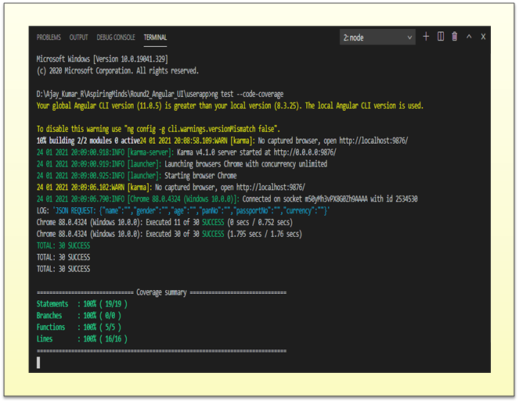
Q8 : Istanbul Code Coverage Report for User Details Component
Unit Test Cases executed : 30 Unit Test Cases.
Passed Unit Tests : 30 Unit Test Cases.
Failed Unit Tests : 0 Unit Test Cases.

Slide 49
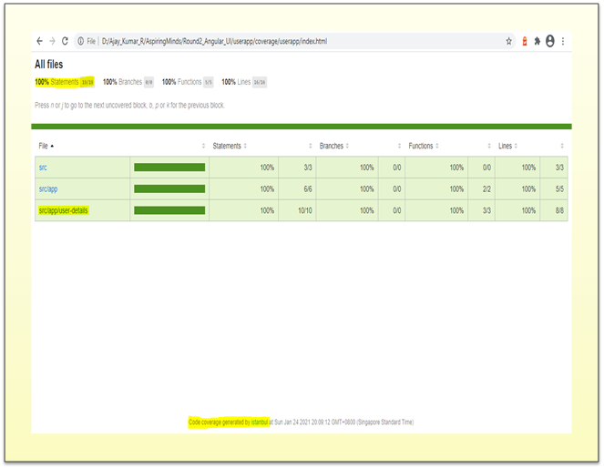
Q8 : Istanbul Code Coverage Report for User Details Component

Slide 50
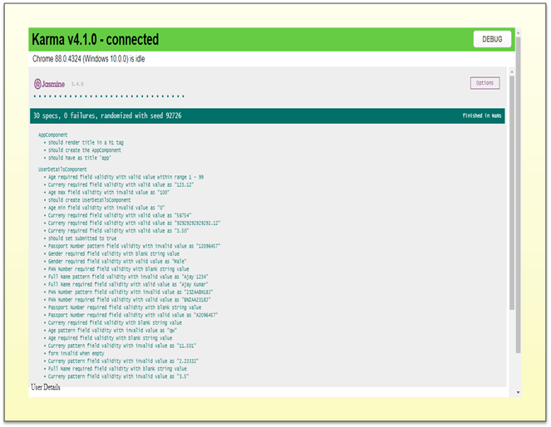
Q8 : Karma Unit Test Cases Report

Slide 51
Q8 : Detailed documents with Explanation & Screenshots.
Note: Detailed documents attached here for further reference

Slide 52
KG Information Systems Private Limited
THANK YOU
AJAY KUMAR R
THANK YOU

